Slide 1


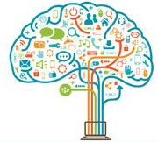

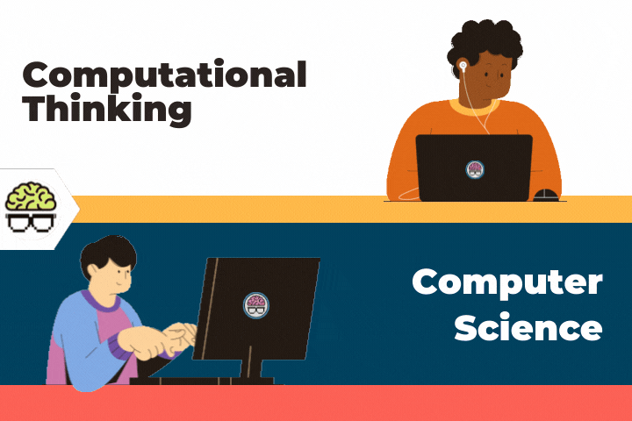

UNIT I | COMPUTATIONAL THINKING | 6
Computational Thinking – Modern Computer - Information based Problem solving– Real world information and Computable Data – Data types and data encoding - Number Systems – Introduction to programming languages - Basics of C programming – variables- data types – keywords – C program structure - simple programs in C

Slide 2
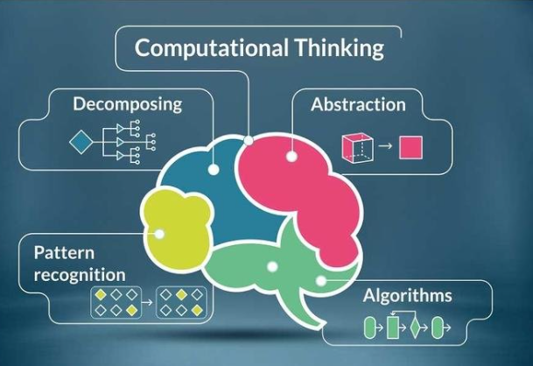
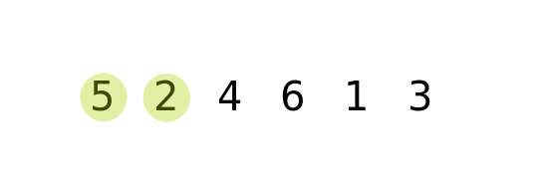
COMPUTATIONAL THINKING
Computational Thinking is a logical approach to problem-solving
It can be applied to ANY problem, task or system

Slide 3
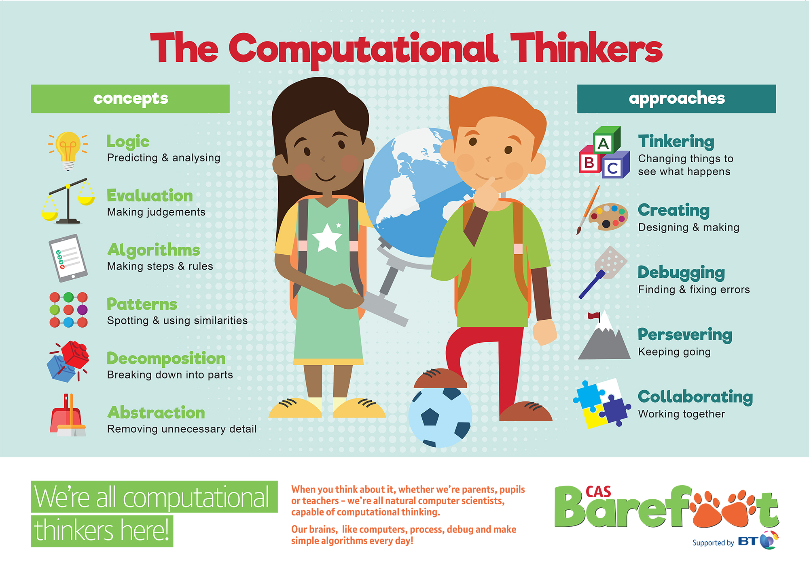
COMPUTATIONAL THINKING

Slide 4
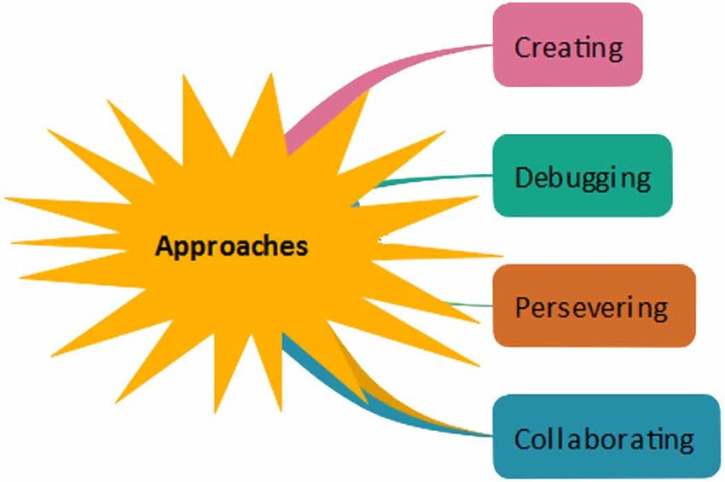
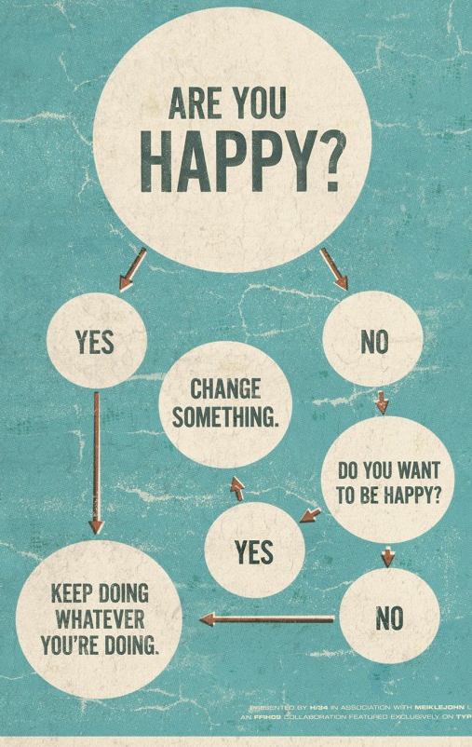
Discussion

Slide 5
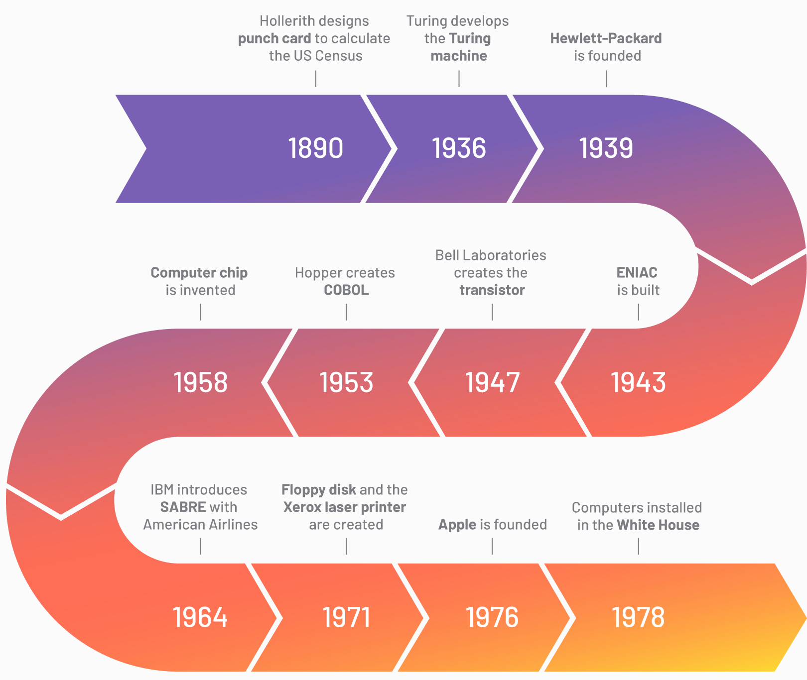
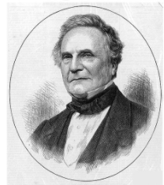
MODERN COMPUTERS
1791-1871
Originated concept of programmable computer
SoI: https://www.g2.com/articles/history-of-computers#computers-1980-1990s

Slide 6
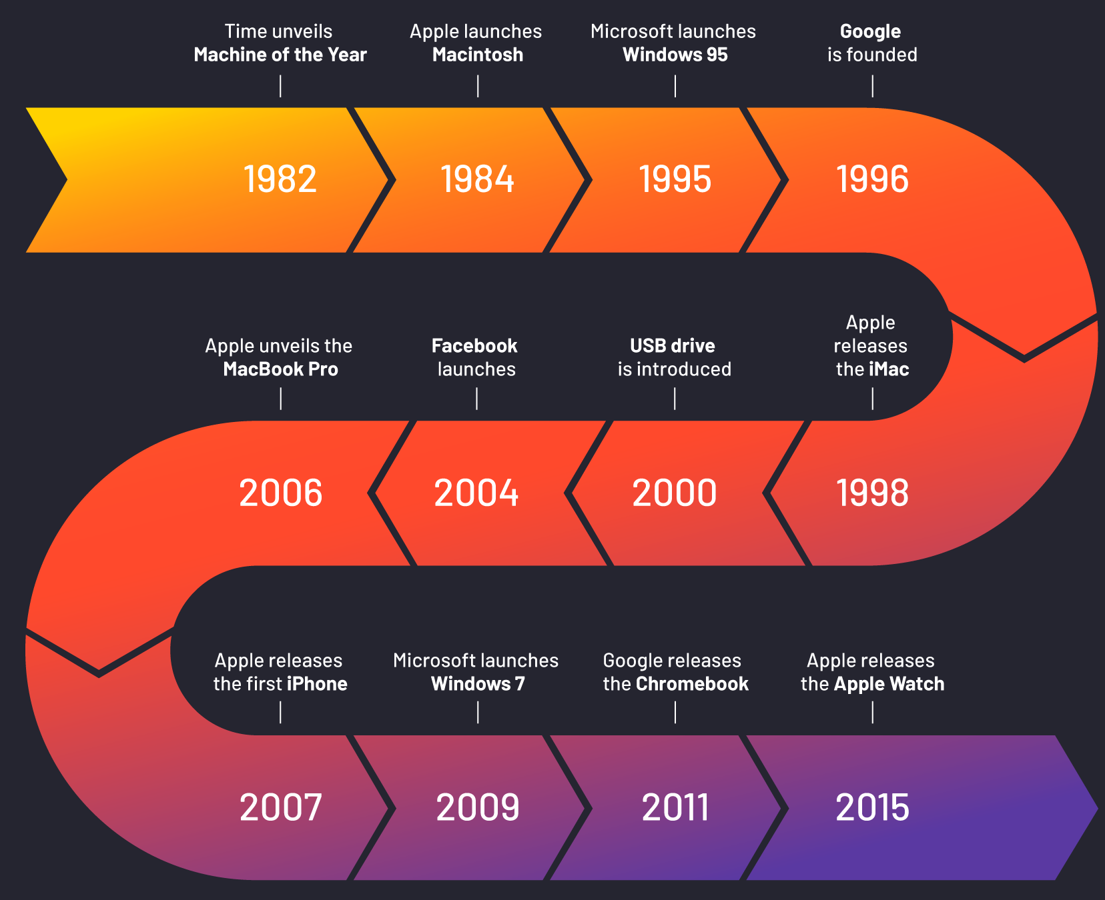
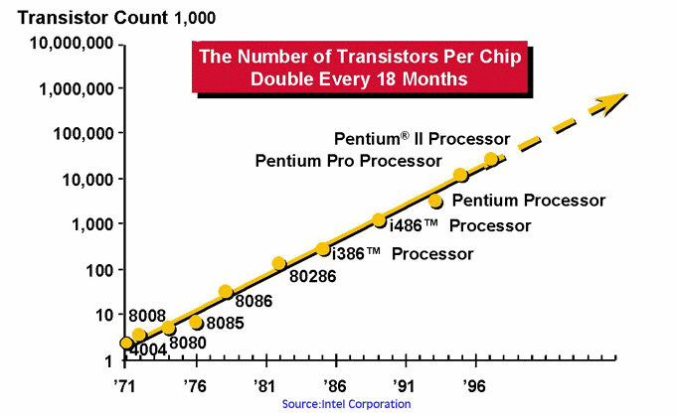

Slide 7
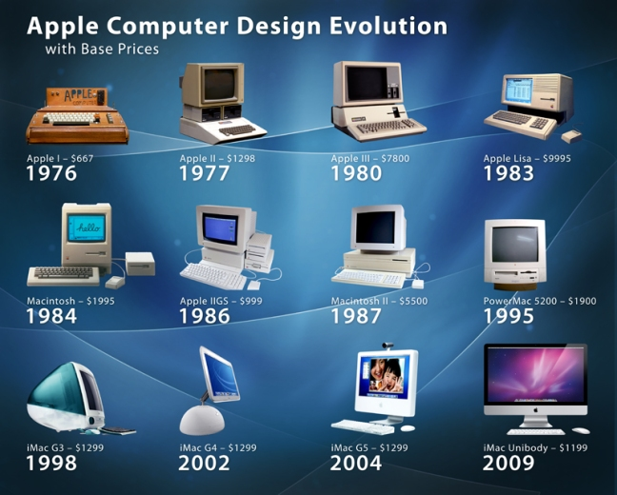

Slide 8
Types of Data
Continuous Data
Data is continuous if there are an infinite number of possible values for an individual datum
The continuous data is usually associated with measurements involving the physical or real world
The weight is exactly 200 grams, it might also weigh 229.3 grams or 229.31533 grams or even 229.31533480185993 grams
Discrete Data
Data is discrete if there are a finite number of possible values
The discrete data is usually associated with things that can be counted.
Are you living with parents? Yes(1)/No(0)

Slide 9

Real world information and Computable Data
To denote an encoding of information such that the information can manipulated by a computing system
The credit card number is information that is turned into data when it is stored on the back of your card
The encoding of this information may take the form of a strip of magnetically charged particles, a one dimensional bar code, a two-dimensional bar code, or even as a pattern of etchings in a radio-frequency identification (RFID) chip.
Your name is also a piece of information that is turned into data when it is stored in a computing system
The encoding may be electrical charges stored on a digital circuit or even as a one- or two-dimensional bar code on the back of an identification badge
The idea that “computational thinking is for everyone” is a piece of information that can also be turned into data by encoding

Slide 10
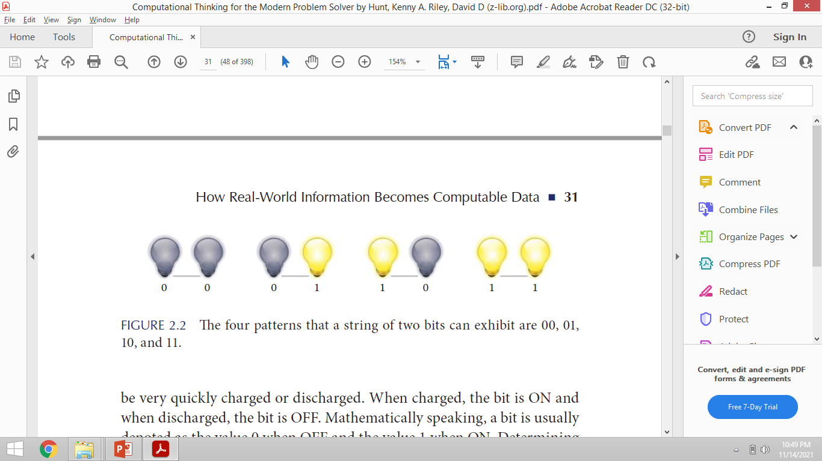
Real world information and Computable Data
In electronics, a signal may be either analog or digital
An analog signal is an encoding of continuous data and the digital signal is an encoding of discrete data
In modern computing systems almost utilize digital electronics
In digital systems, the smallest unit of data is known as a binary digit, or bit
At any point in time, a bit can only take on one of two possible values: ON or OFF
When charged, the bit is ON(1) and when discharged, the bit is OFF(0)

Slide 11
Real world information and Computable Data
The computing systems encode all information as a sequence of bits
Example: Pictures, sound, textbooks, and video are encoded as long sequences of bits
A sequence of bits is commonly referred to as a bit string
The bits in the string are formed using bit 1 or 0
A bit string is able to display a great number of different patterns
Example: For single bit there are only two patterns that the string could
A string of two lightbulbs. How many different patterns could the string exhibit?

Slide 12
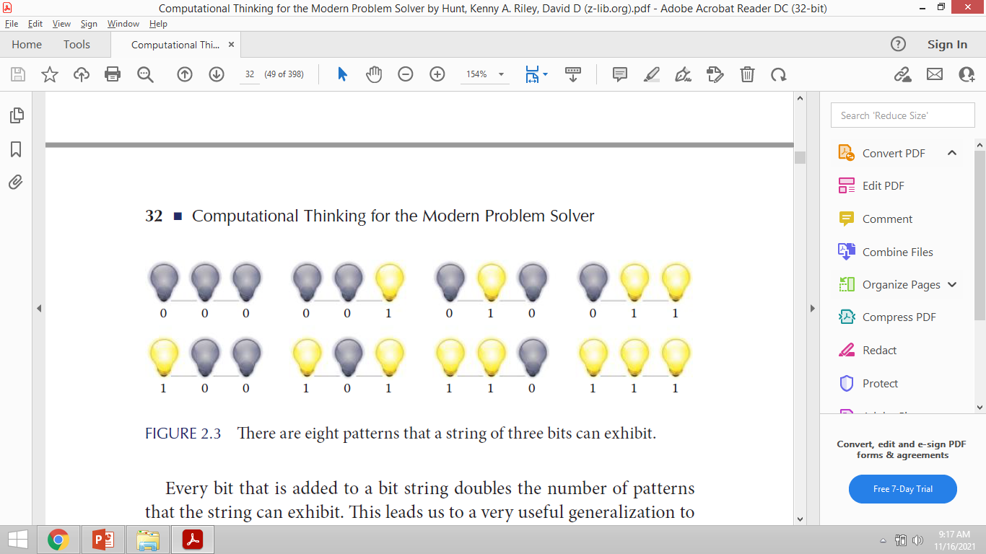
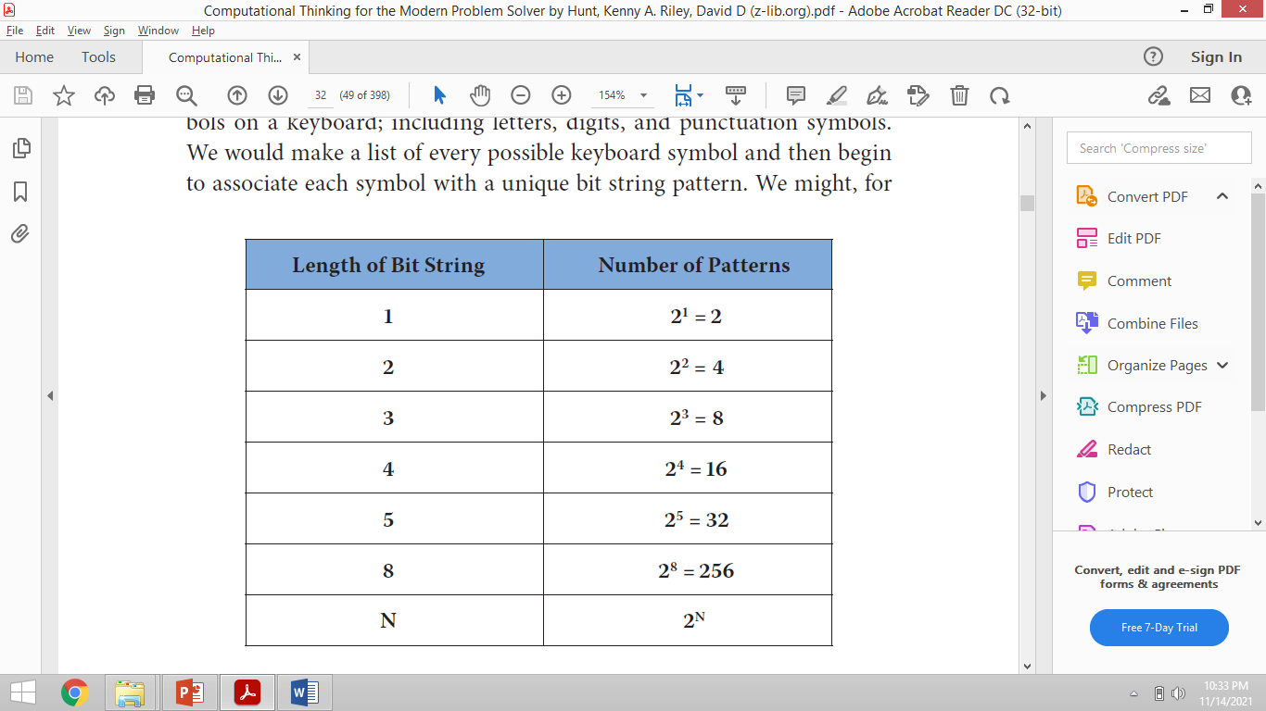
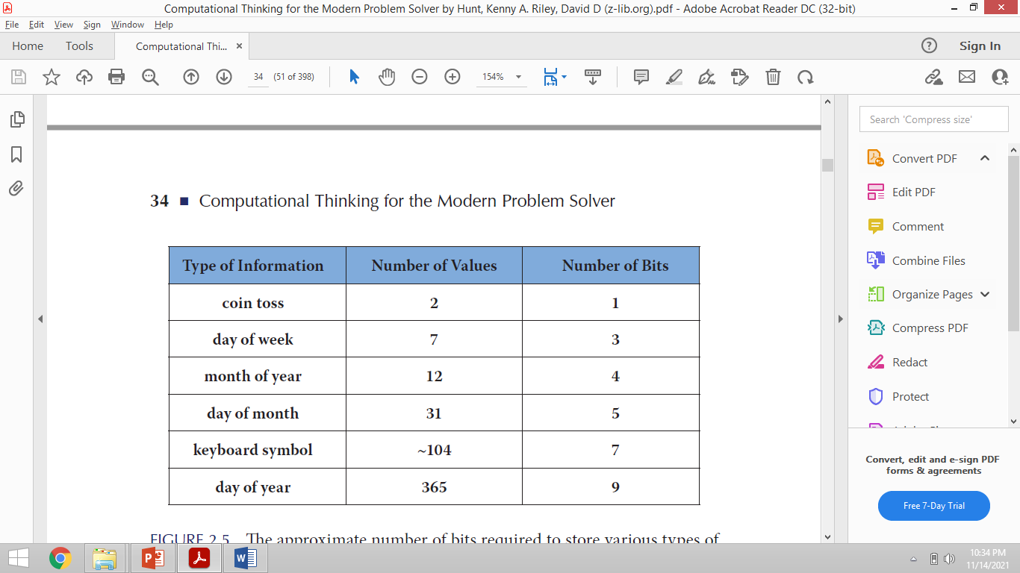
Real world information and Computable Data
How many different patterns could the string exhibit?

Slide 13
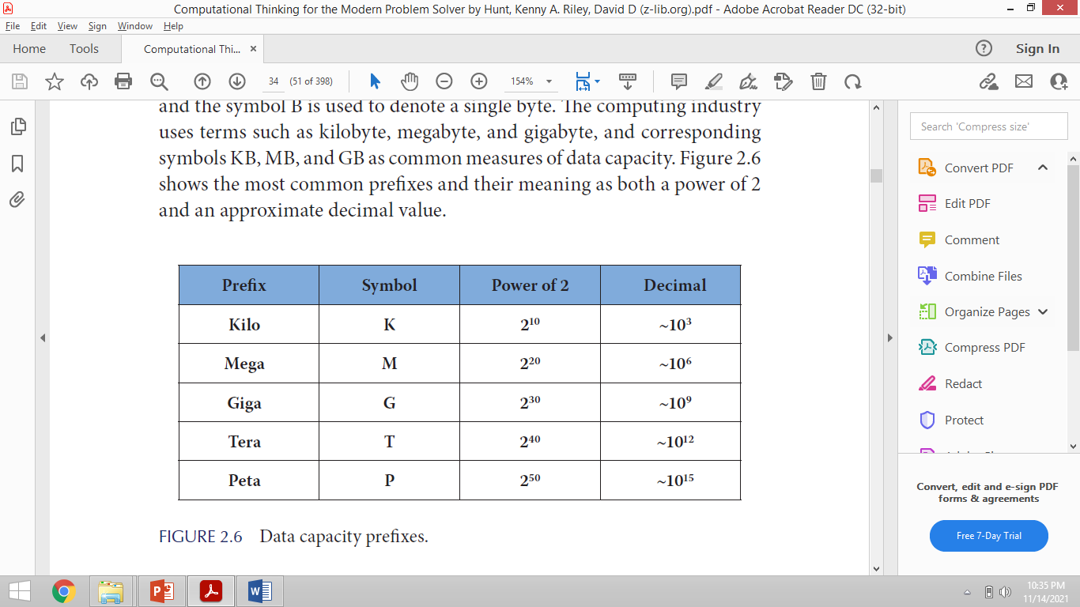
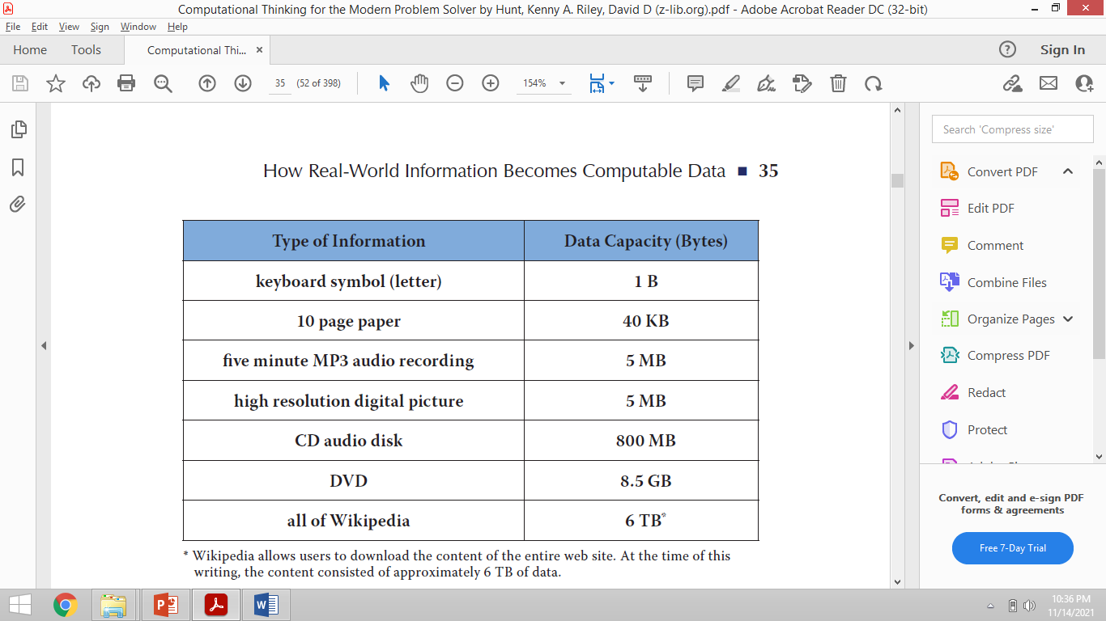
DATA CAPACITY
Data encoding requires us to know how many bits are required to store a piece of information
The data capacity of a computing system is the amount of information that can be encoded by the system

Slide 14
DATA TYPES AND DATA ENCODING - PICTURE
All digital data is encoded as a sequence of bits and that information is associated with the various patterns
Specific types of information are encoded and describes some of the inner workings of a computing system
how colors, pictures, and sound can be encoded?
The human eye perceives color through three types of biological photosensors known as cones
Each cone is attuned to one of three wavelengths that correspond roughly to red, green, and blue light
The RGB model uses red (R), green (G), and blue (B) as the primary colors
Any color can be created by combining different amounts of these three primaries
A color is usually encoded as three integer numbers (0-255)
For 256 different values, a bit string of length eight is______________

Slide 15
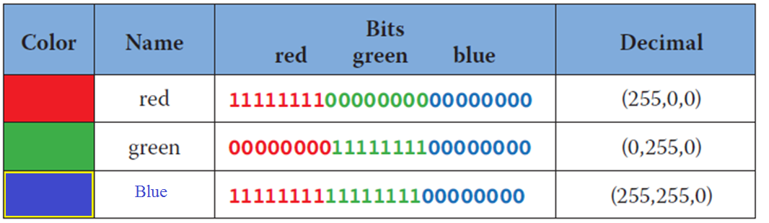
DATA TYPES AND DATA ENCODING - PICTURE

Slide 16
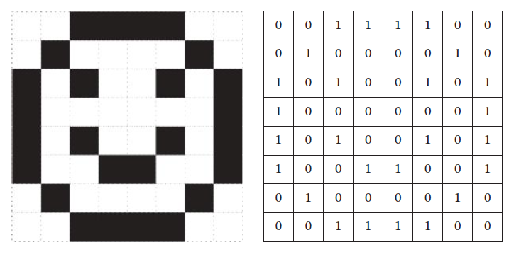
DATA TYPES AND DATA ENCODING - PICTURE
The most common encoding of a digital image is that of a two-dimensional grid of colors
Each element of the grid is known as a pixel
A image has 1920 columns and 1080 rows
of pixels
1920 × 1080 = 2,073,000 pixels
For bit string of length 24,
1920 × 1080 × 24 = 49,766,400 bits

Slide 17
DATA TYPES AND DATA ENCODING - SOUND
your voice is digitally encoded by your cell phone prior to being delivered to the person at the other end of the call
Sound is a physical phenomenon caused by waveforms that propagate through the air
A microphone is used to transform the waveform into an analog electric signal after which the analog signal is sampled to produce a digital encoding.
Sampling is a process where the strength of a changing signal is measured at regular time intervals and those measurements are then recorded. [the sound wave is converted into a sequence of numeric values]
The average person can hear sound waves 20 Hz up through about 20,000 Hz or 20 kHz

Slide 18
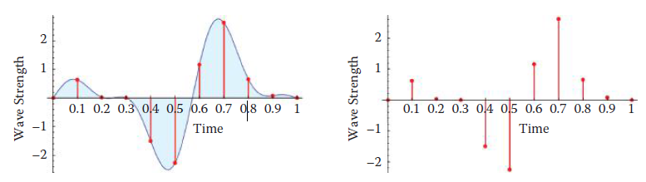
DATA TYPES AND DATA ENCODING-SOUND
Consider a song that is five minutes long and is sampled at a rate of 48 kHz for recoding on a digital audio tape.
To determine the number of samples required to encode the song we must note that there are 48,000
samples taken every second
The song will be encoded as a sequence of 48000 × 5 × 60 = 14,400,000 samples
Data compression is often very useful because it reduces the consumption of resources such as hard disk space

Slide 19
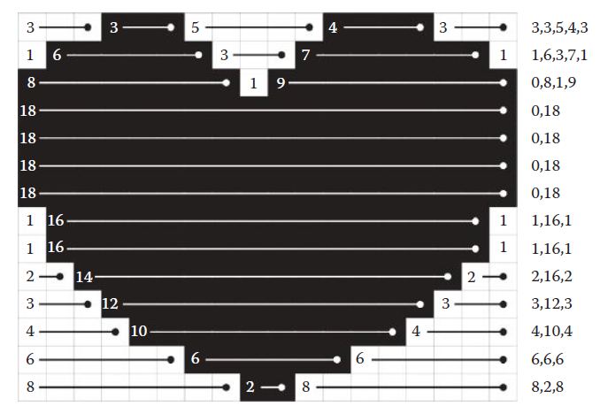
DATA COMPRESSION – RUN LENGTH ENCODING
One row of the image may contain the 32 pixel sequence 11111111110001111111111111111111
This information can be encoded as the 3 byte sequence {10, 3, 19}
An image has 18 columns and 14 rows
18 × 14 =252
Totally 43 runs
Encode each run using five bits
43 × 5 = 215

Slide 20
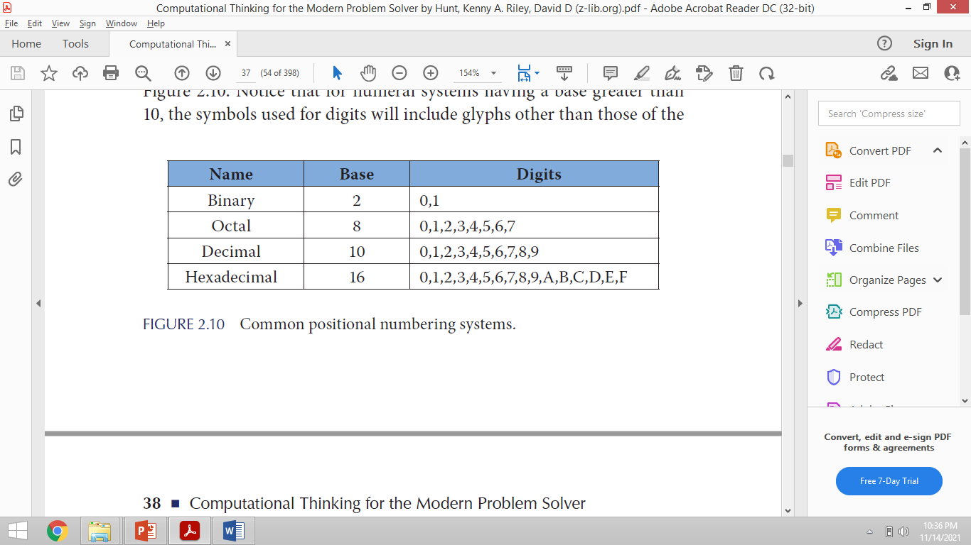
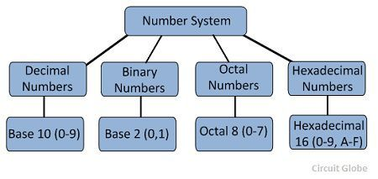
Number system

Slide 21

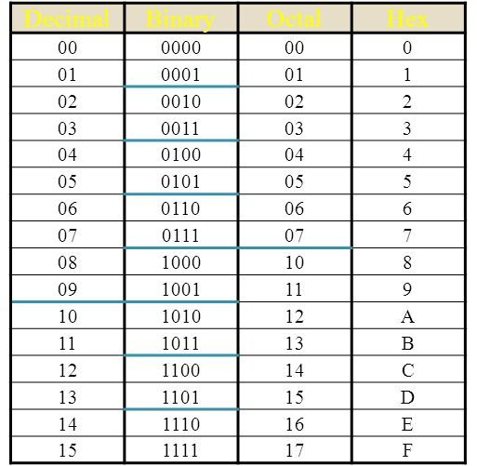
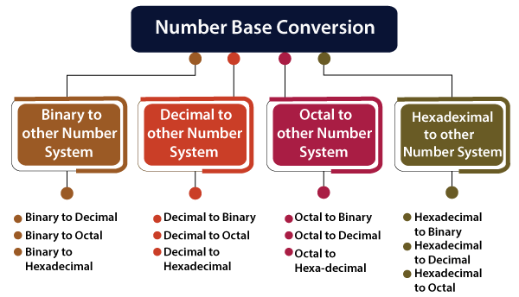
Number System Conversion

Slide 22
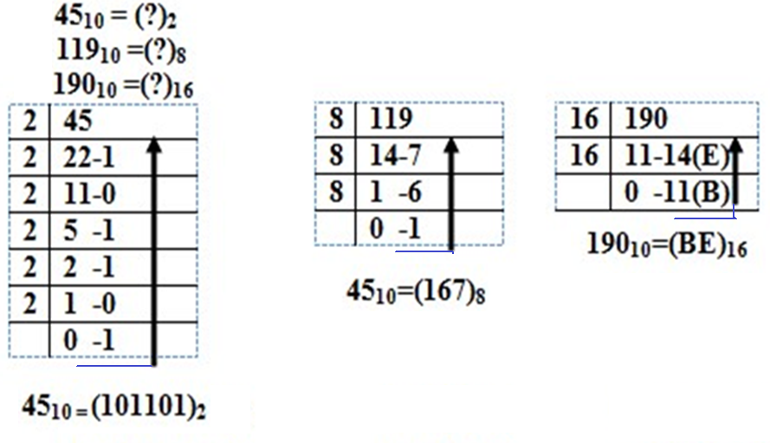
Decimal to other system

Slide 23
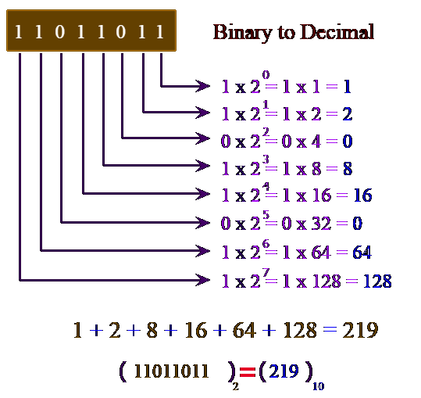
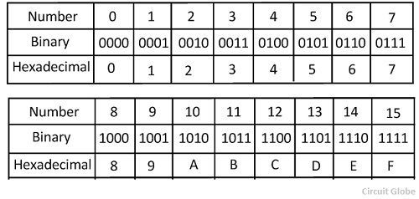
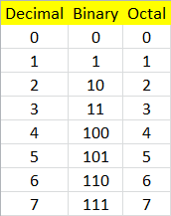
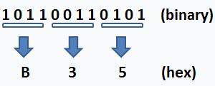
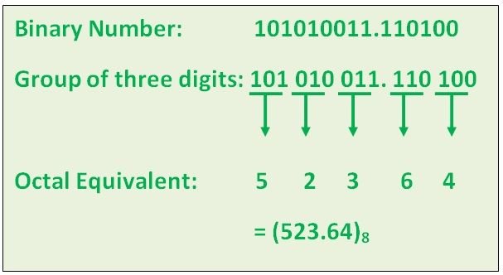
Binary to other system
Binary to Hexadecimal Number
Binary to Octal Number

Slide 24
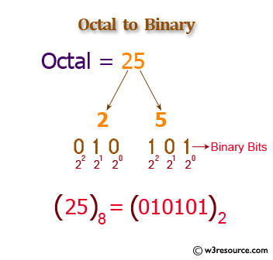
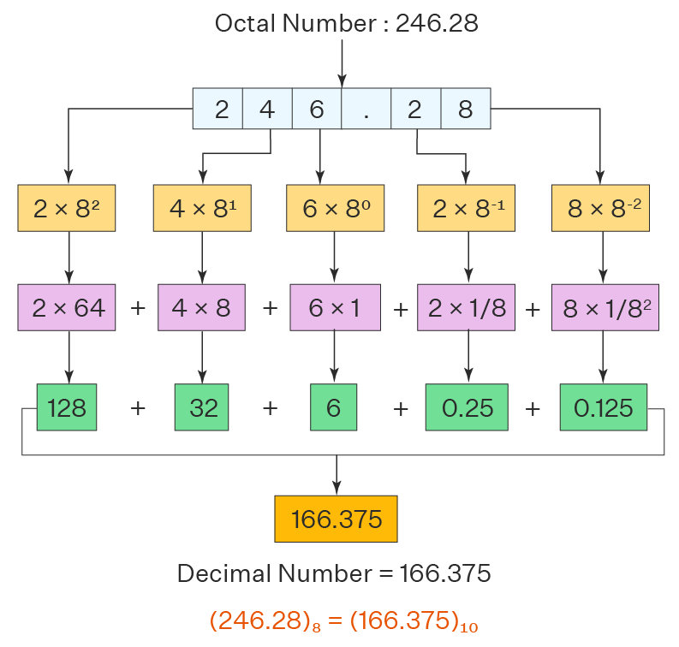
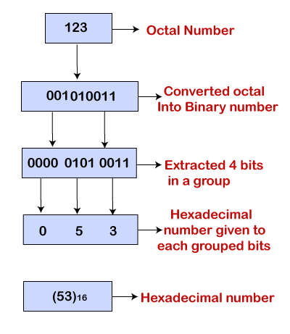
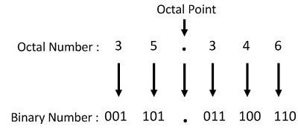
Octal to other system

Slide 25
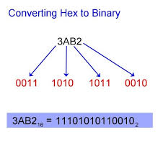
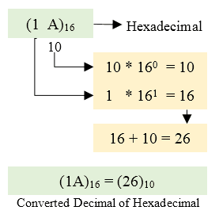
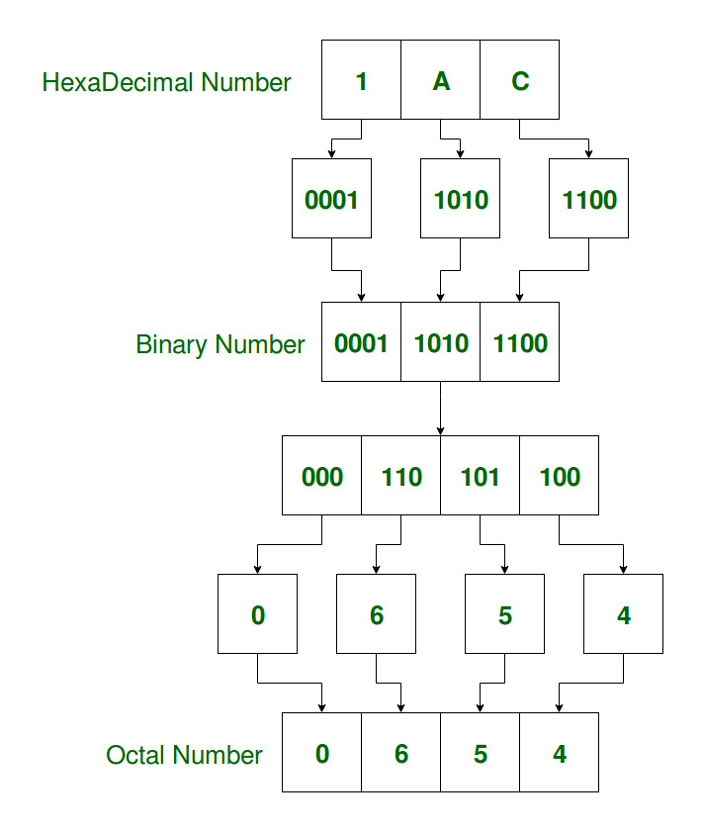
Hexadecimal to other system

